Slide 1
Learning to Group Discrete Graphical Patterns
Zhaoliang Lun*ª Changqing Zou*^{b} Haibin Huang ª Evangelos Kalogerakis ª
Ping Tan ^{b} Marie-Paule Cani ^{c} Hao Zhang ^{b}
ª UMASS Amherst
^{b} Simon Fraser University
^{c} Ecole Polytechnique
Notes:
Thanks for the introduction. Good morning everyone, My name is Changqing Zou, In this talk, I will present our work on Grouping Discrete Graphical Patterns.

Slide 2
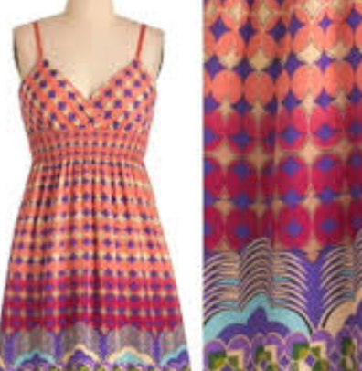
Graphical Patterns
Textile
Vector Art
Facade
Notes:
Graphical Patterns are often encountered in our daily lives. They can be found in many kinds of data such as Textiles, 2D Vector arts lik, and Facades.

Slide 3
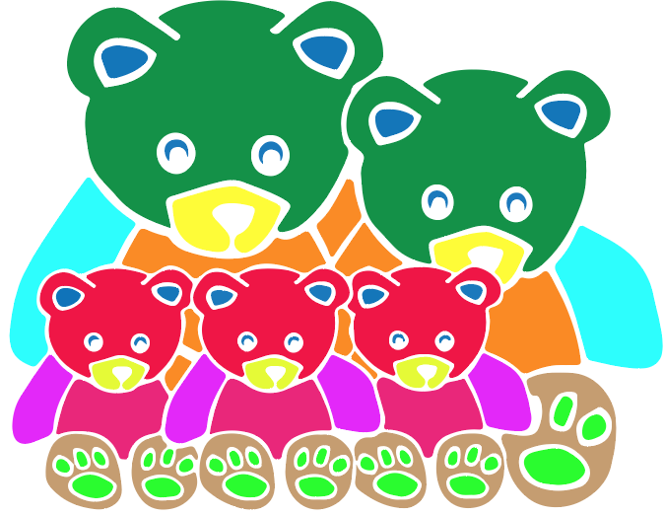
Pattern Grouping Problem: motivation
Pattern Grouping
Notes:
Given a set of pattern elements, we seek a grouping based on

Slide 4
Pattern Grouping Problem: motivation
Similarity
Symmetry
Pattern Grouping
Continuity & Proximity
Notes:
criteria such as symmetry, similarity, continuity and proximity. in many cases these criteria are mixed and it is unclear how to select the most appropriate or how to properly weight their importance.

Slide 5
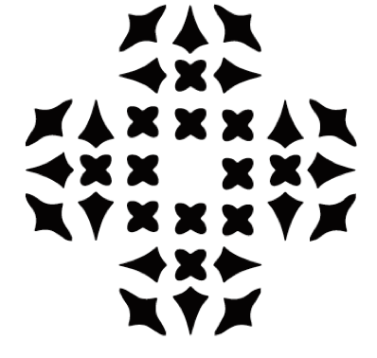
Challenges (1): conflicting grouping principles
Input Pattern
Symmetry rule wins
Similarity rule wins
Notes:
This problem is not easy, even in the case of 2D patterns, there are many challenging scenarios. Take this simple and regular pattern as an example, different perceptual grouping principles would lead to conflicting grouping results. It is unclear which grouping principles should take precedence.

Slide 6
Challenges (2): various noises
Notes:
In real data, patterns are usually neither regular nor simple, often having various degree of noises. For examples,

Slide 7
Challenges (2): various noises
Inaccurate Symmetry
Loose Similarity
Notes:
This pair of bear ears are not accurately symmetrical. And this pair of mouths are only roughly similar.

Slide 8
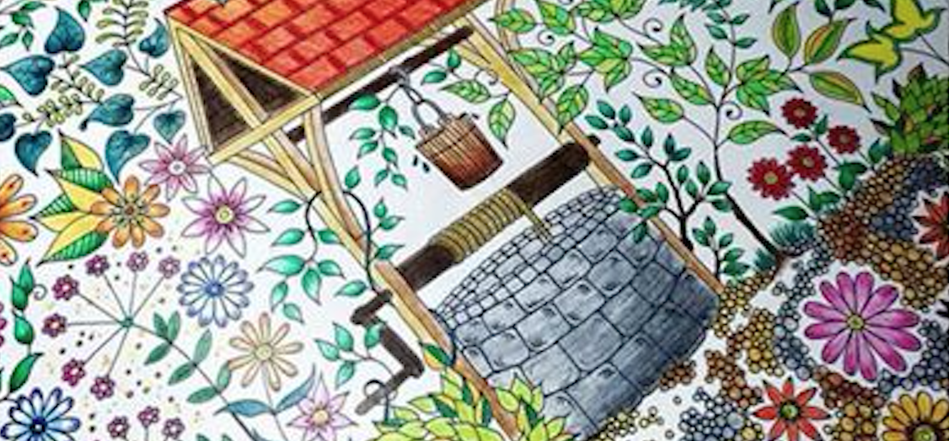
Challenges (3): Rich Variations and Complexity
Notes:
There is also a challenge in the variations and complexity of the real data. People always say, no two leaves are exactly the same. This also happens to the real world cases we are looking at. However, we can still identify the symmetry patterns. We would like our algorithm to do the same thing. Despite its challenging, this problem is very useful. It can be used in many pattern related applications

Slide 9
Applications of Pattern Grouping
Pattern Editing
Inverse Procedural Modeling by Automatic Generation of L-systems. O. Stava, et al. 2010
Notes:
such as Pattern Editing, Pattern Exploration, and Layout Optimization

Slide 10
Applications of Pattern Grouping
Pattern Editing
Pattern Exploration
PATEX: Exploring Pattern Variations. P. Guerrero, et al. 2016
Notes:
Pattern Exploration, and Layout Optimization where automatic pattern grouping will significantly lessen user’s interactions

Slide 11
Applications of Pattern Grouping
Pattern Editing
Pattern Exploration
Layout Optimization
GACA: Group-Aware Command-based Arrangement of Graphic Elements. P. Xu, et al. 2015
Notes:
and Layout Optimization. We are not the first to propose this very useful problem

Slide 12
Related Work: Model & Rule Driven
Gestalt-based pattern grouping
Conjoining Gestalt Rules for Abstraction of Architectural Drawings. Nan et al. TOG, 2011.
Perceptual grouping by selection of a logically minimal model, Feldman, ICCV, 2003.
The whole is equal to the sum of its parts: A probabilistic model of grouping by proximity and similarity in regular patterns, Kubovy & Berg. Psychological Review, 2008.
Symmetry-based pattern grouping
Folding meshes: hierarchical mesh segmentation based on planar symmetry. Simari et al. SGP, 2006.
Co-Hierarchical Analysis of Shape Structures. O. Kaick et al. TOG, 2013.
Symmetry Hierarchy of Man-Made Objects. Wang et al. Computer Graphics Forum, CGF, 2011.
Layered Analysis of Irregular Facades via Symmetry Maximization. Zhang et al. TOG, 2013.
Notes:
Actually, there are two major lines of work on this topic. One direction is to apply Gestalt rules, Another direction is to detect symmetries between elements.

Slide 13
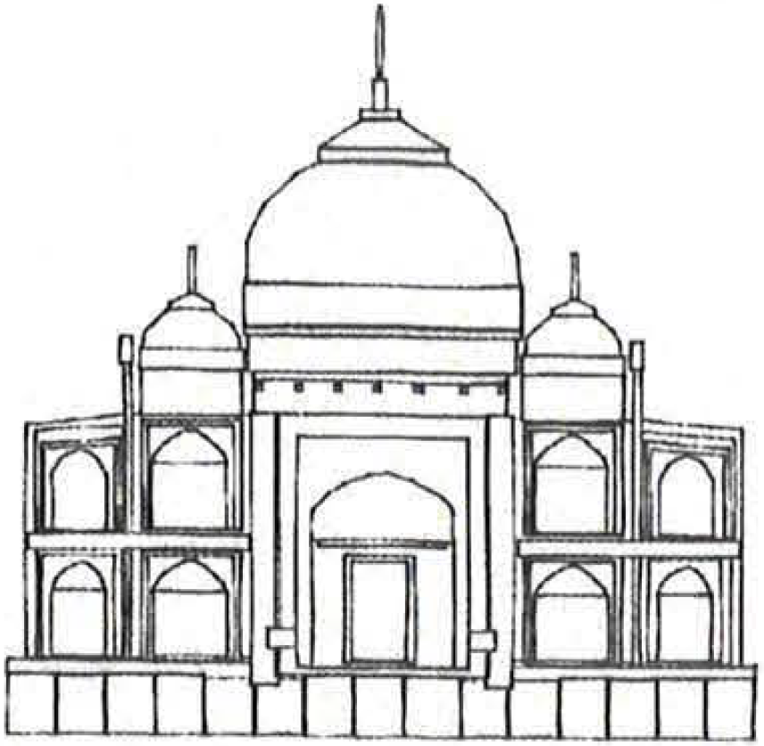
Related Work: Gestalt-Based Pattern Grouping
Group & Simplify
Conjoining gestalt rules for abstraction of architectural drawings,
Nan et al. TOG, 2011.
Notes:
The most relevant work is Nan’s SIGGRAPH project in 2011. which tries to quantify Gestalt rules in an energy-based optimization approach. This approach works well in grouping building façade patterns which have lots of perfect symmetries and regularities. But the problem we are trying to tackle in this paper has more noisy inputs.

Slide 14
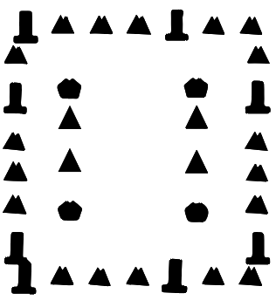
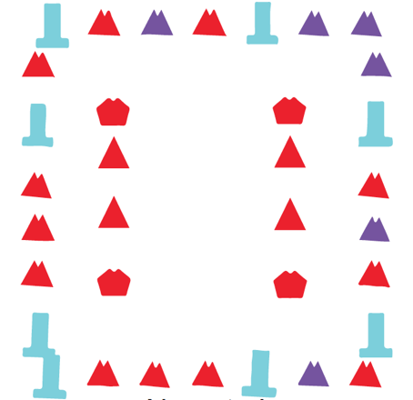
Nan’s Strategy: model-driven
Hand-engineering rules to quantify grouping models
Hand-tuning relative importance of rules
Nan et al ’s strategy
Notes:
The main characteristics of previous work focus on two aspects: coming up hand-engineering rules for the task, and hand-tuning the relative importance of rules.
Unfortunately, this strategy is not robust to the noise. Taking this case for example, we will expect the elements forming the outer square being grouped together. But a direct use of Nan’s strategy fails to achieve the goal.

Slide 15
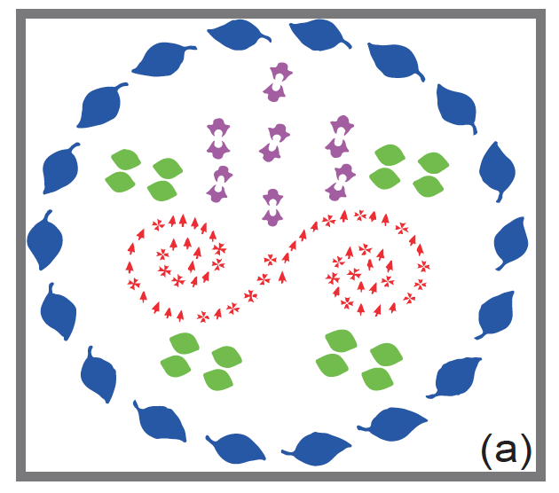
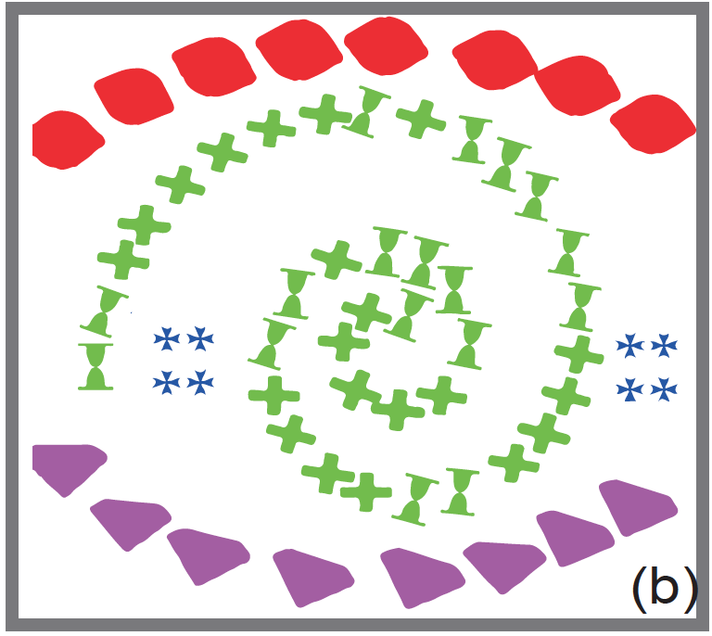
Our Work: First data-driven approach
Learning to group discrete graphical patterns from human annotations
Loosely consider Gestalt principles
Learn relative importance of features, without hand-engineer rules
Robust noise handling thanks to learning approach
Convey
Notes:
So we turned to another way. Don’t Explicitly design features and don’t manually set the feature weights. We Proposed a data-driven strategy. We let the machine “see” many patterns with ground-truth grouping information. We expect the grouping rules can be generalized to more data. For example….

Slide 16
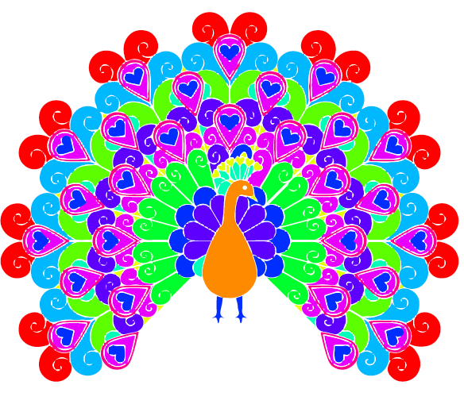
Our Strategy
Learning to group discrete graphical patterns from human annotations
Loosely consider Gestalt principles
Learn relative importance of features, without hand-engineer rules
Robust noise handling thanks to learning approach
Generalize
(b)
Notes:
Instead, we propose a data-driven strategy. We don’t hand-design features and we don’t hand-tune the feature weights. We let the machine “see” many synthetic patterns with ground-truth grouping information. We expect a grouping strategy can be discovered automatically and can be generalized to real data.

Slide 17
Our Solution: learn features for clustering
Learned feature descriptor for each elements
Clustering in learned feature space
Notes:
In a nutshell, we are trying to learn a feature descriptor for each element such that this feature descriptor is suitable for grouping. As long as we have established a feature space for the elements, any clustering strategy can be applied for the grouping task.

Slide 18
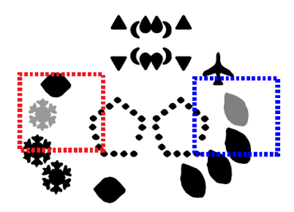
Our Solution: bottom-up strategy
Learned feature descriptor for each elements
Clustering in learned feature space
Notes:
Initially each element is a group. We merge the closest two groups in the feature space, and repeat until we reach our targeting number of groups. This is called agglomerative clustering. This may be the most intuitive clustering algorithm. We have experimented several different clustering strategies and I will show the comparison later.

Slide 19
Our Solution: learn features for clustering
Learned feature descriptor for each elements
Clustering in learned feature space
Not optimize the clustering algorithm itself
Learn a feature space suitable for clustering
Notes:
Again, I would like to emphasize that we are not optimizing the clustering algorithm itself. Our goal is trying to learn a feature descriptor for each element, or in other words we are trying to learn a representation space for those elements such that doing clustering in this space can yield better grouping results

Slide 20
Our Solution
Element -> learned feature descriptor
Clustering in learned feature space
Not optimize the clustering algorithm itself
Learn a feature space suitable for clustering
Notes:
But what should we consider in learning the features? We still hope that our learned features can reflect the general principles in pattern grouping. So we will need a learning model that is capable of capturing those principles.

Slide 21
Feature Learning: how do human group
Notes:
Before teaching machine to learn grouping. Let's first manually do the grouping on this teddy bear. Then we can see if human experience could migrate to machine. Through this, we hope to find which learning model is most suitable for capturing each principle.

Slide 22
Feature Learning: how do human group
Similar & close-by
Notes:
We can see these little toes in this teddy bear are similar and close to each other. It’s intuitive to group them together.

Slide 23
Feature Learning: how do human group
Horizontal Alignment
Notes:
Also for the bodies of those 3 little bears, they are forming a horizontal alignment. Thus it also makes sense to make them a group.

Slide 24
Feature Learning: how do human group
How can we migrate human experience into machine learning?
Notes:
For the two arms of the two big bears, although they are pretty far away, they show some kind of symmetry and can be group together. That is how we human will think about grouping. How can we migrate this human experience into machine learning?

Slide 25
Feature Learning: local Information
Similarity
----- Shape-Aware
Continuity
Proximity
Context-Aware
Local Information
Notes:
We can see that the 'similarity' principle is related to element's shape while the proximity and continuity principle is related to element's context. They only capture the local information on individual elements so here we only need a model that can learn from local information

Slide 26
Feature Learning: global Information
Similarity
----- Shape-Aware
Continuity
Proximity
Context-Aware
Local Information
Symmetry
----- Structure-Aware
Global Information
Notes:
On the other hand, the symmetry principle is related to the overall structure so here we will need another learning model that can integrate the global information. Therefore we tackle this grouping problem using two different neural network models simultaneously.

Slide 27
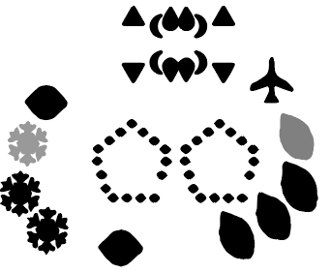
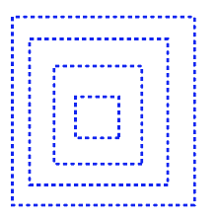
Local feature: Atomic Element Encoder
Notes:
Its output is a 32-D feature vector for each element. This feature vector is specifically designed to focus on the local information of the element since we constrain its perception field within the local context

Slide 28
Local feature: Atomic Element Encoder
Notes:
The first network is called Atomic Element Encoder which captures the local context of the elements. The input to this network contains 4 different scale of contexts around the element we are looking at. The network has a structure following Alex-Net.

Slide 29
Local feature: Atomic Element Encoder
Notes:
The first network is called Atomic Element Encoder which captures the local context of the elements. The input to this network contains 4 different scale of contexts around the element we are looking at. The network has a structure following Alex-Net.

Slide 30
Local feature: Structure Encoder
Notes:
The other network is called Structure Encoder which captures the global information. It feeds the entire image to the network. The network has an encoder-decoder structure with U-Net connection. The network outputs feature maps that have the same resolution as the input. These feature maps are able to integrate global information since now the network can perceive the entire image.

Slide 31
Global feature: Structure Encoder
Notes:
The other network is called Structure Encoder which captures the global information. It feeds the entire image to the network. The network has an encoder-decoder structure with U-Net connection. The network outputs feature maps that have the same resolution as the input. These feature maps are able to integrate global information.

Slide 32
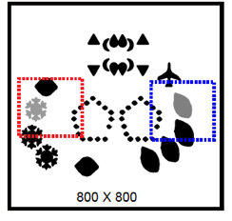
Network Architecture
Atomic element
Encoder
Structure
Encoder
45
8M
training pairs
Location & Size
45
Notes:
The entire network architecture is like this. Besides the features extracted from the Atomic Element Encoder network and the Structure Encoder Network, we also fuse the location and size information directly into the final feature vector.

Slide 33
Network Architecture
Atomic element
Encoder
Structure
Encoder
45
8M
training pairs
Location & Size
45
Notes:
To train this network, we use a contrastive loss: it tries to pull two elements having the same group labels closer in the feature space, and push away two elements with different group labels.
The next question is how do we gather training data.

Slide 34
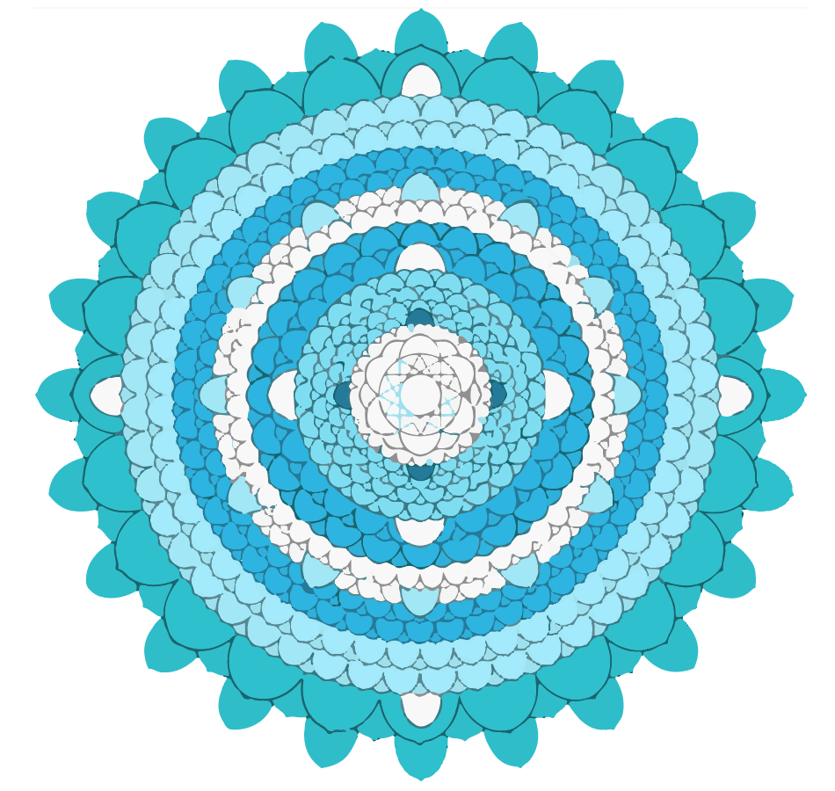
Data Collection: Lack of suitable patterns on the web
Black & White
Color Gradient
Lack Structural Variety
Notes:
This task is not trivial. First, on the web, a great proportion of graphical patterns are binary images. Second, some patterns on the web have no flat colorized regions. In other word, in some regions, there is color gradient. It is hard to get the GT from these kinds of data. Lastly, although we can obtain the GT from some colorized patterns like this mondala from the web without much effort . However, this kind of data usually only have a small range of structural variety.

Slide 35
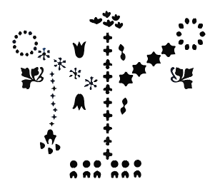
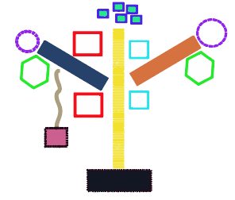
Layout Templates Based Training Data Collection
Layout Template
Pattern Examples
Notes:
Manually Creating patterns with GT is impractical. We turn to a semi-automatic way.
We first manually created pattern layout templates , and then generated pattern examples from these layout templates by inserting various elements

Slide 36
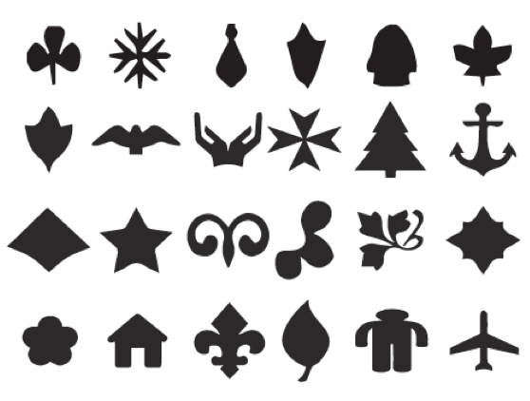
Training Data: element collection
deforming
complexing
Basic atomic elements
adding noises
Notes:
We collected 86 basic atomic elements. To augment the elements, we produced new atomic elements by deforming these basic atomic elements.
We also turned the Atomic elements into more complex elements procedurally. Moreover, we also introduced various noises into the synthesized patterns.

Slide 37
Training Data Collection
~800 pattern layout templates
~8K pattern images
500 positive and 500 negative pairs of elements
∼8M training pairs
Notes:
We finally collected ~800 pattern layout templates, almost 8K pattern images, We totally collected nearly 8M training pairs. Next we show results of our work.

Slide 38
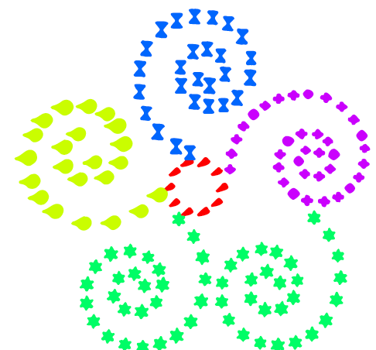
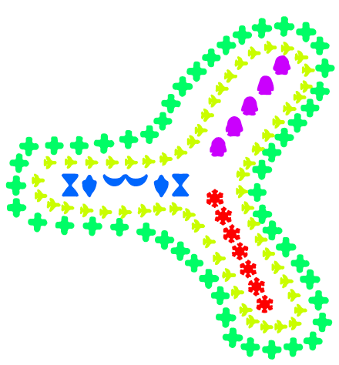
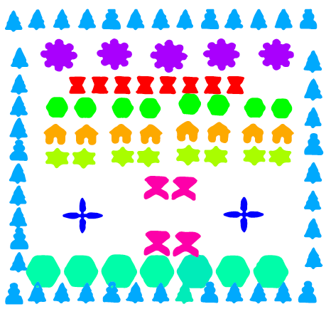
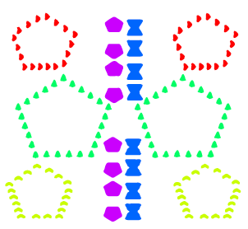
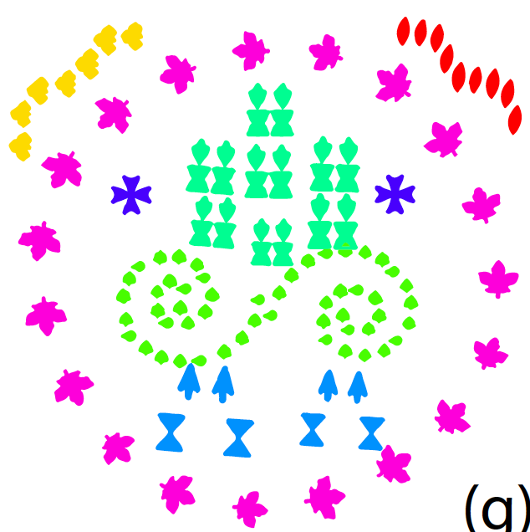
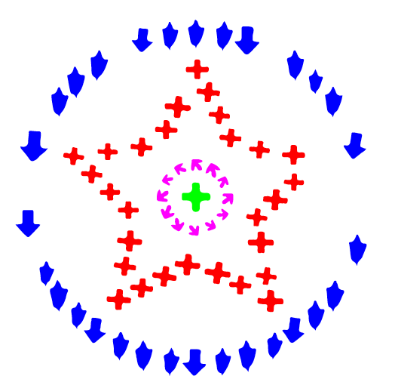
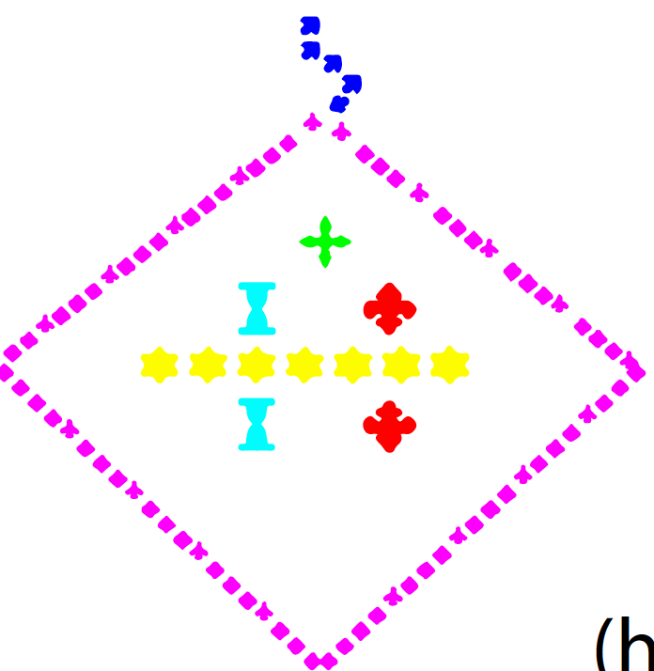
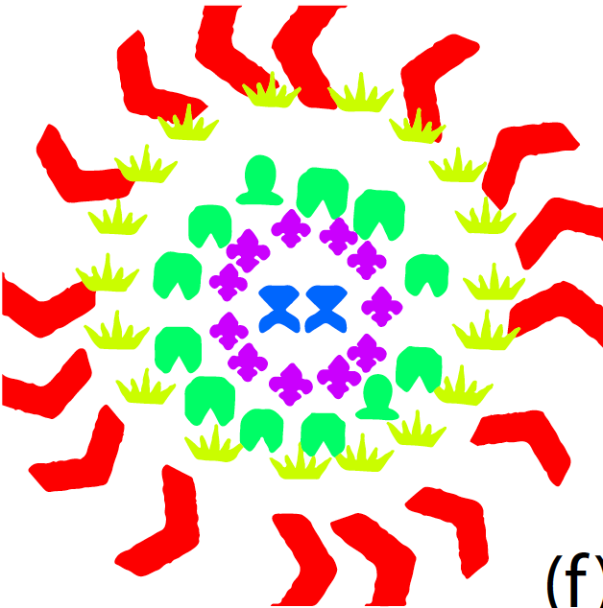
Results on synthesized patterns
Notes:
We first tested our method on the synthesized data. We got good results on most of those examples.

Slide 39
Grouping Results on synthesized patterns
Clover
Arrow
Notes:
Let us see the result of this pattern, Our method can group these arrows with Clovers even a long path of the circle has no element.
Although the cross in the middle of this pattern is very similar with these crosses on the pentagram path. Our model separates them into two groups, which is consistent with human conception

Slide 40
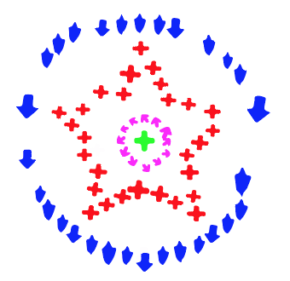
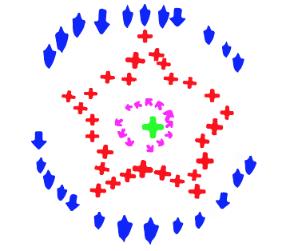
Results on synthesized patterns
Noise level increase
Notes:
Even we increased the noise level. The results were still good.

Slide 41
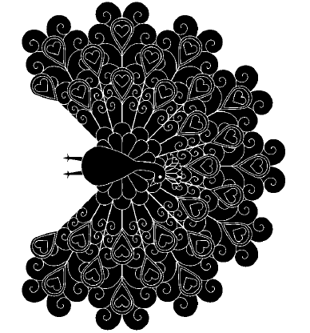
Results on downloaded patterns
Notes:
We also tested our modal on about 200 binary image patterns searched from the google and bing image by the keyword “coloring pages”. See this peacock，our model can get reasonable groupings on most elements. There are also several grouping errors like this small, occluded, piece of feather. It was grouped with other small piece of feather.

Slide 42
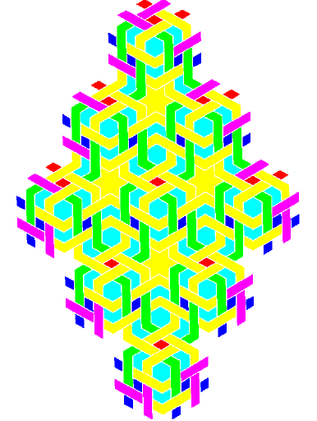
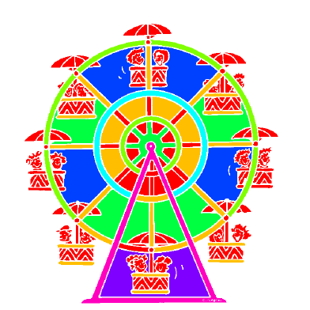
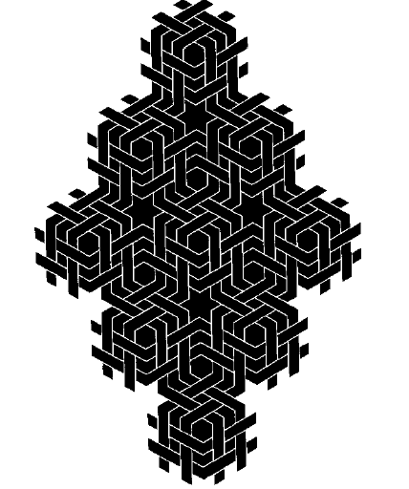
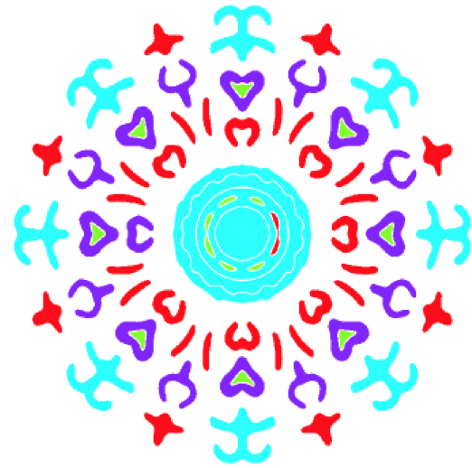
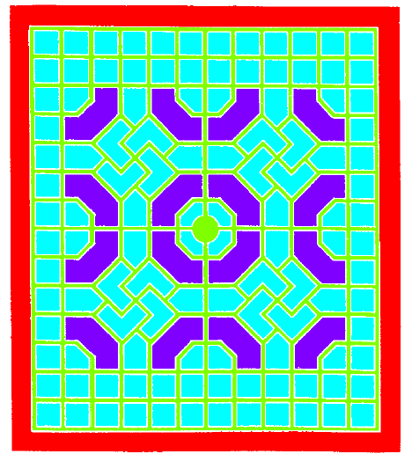
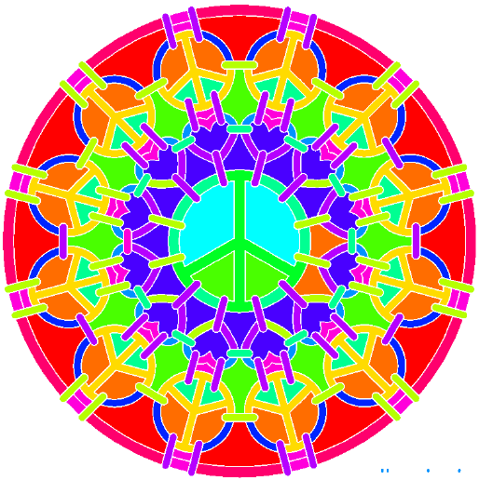
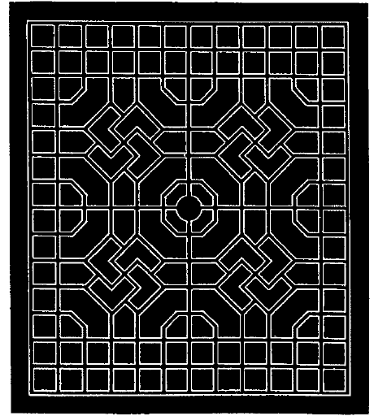
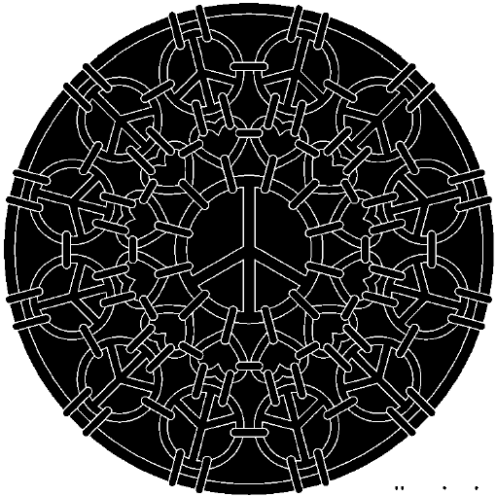
Results on downloaded patterns
Notes:
Here are results of some other relatively regular patterns . Most the results are reasonable.

Slide 43
Results on downloaded Challenging patterns
Notes:
Some of our test patterns like this tree pattern are very Organic, having strong noises. Here we can see the out grouping results of this tree pattern are consistent with human perception on most elements. But there are still some failed cases. Our method did not group these two small twigs with the trunk of the tree.

Slide 44
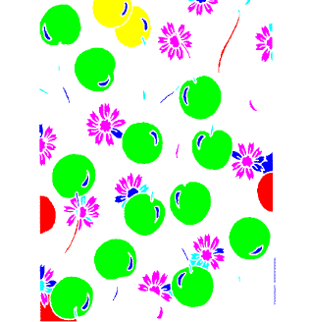
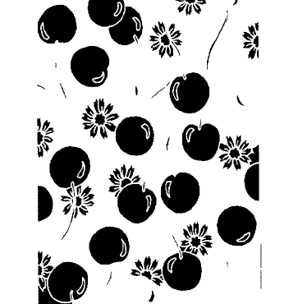
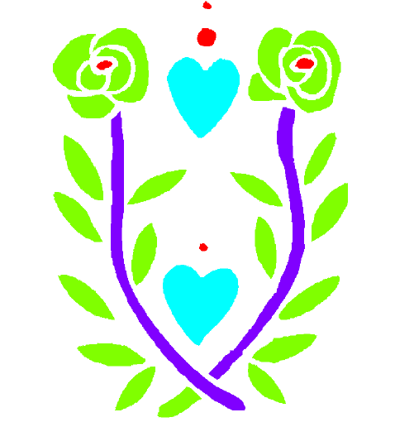
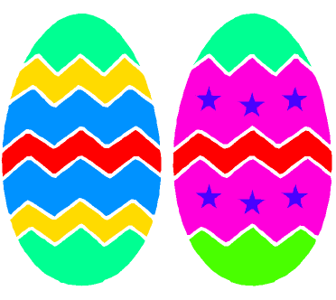
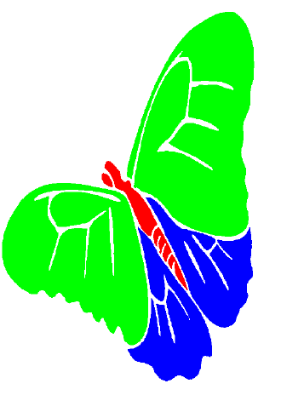
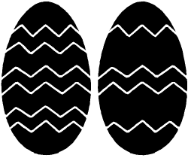
Results on downloaded Challenging patterns
Notes:
Here are grouping results of some challenging examples

Slide 45
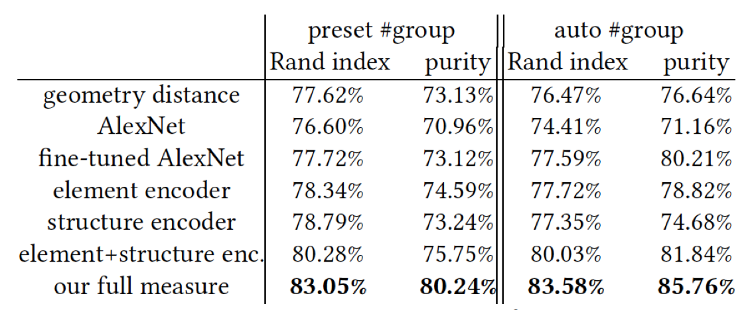
Quantitative Results with various measures and alternatives
Greater score mean better grouping results
Notes:
Here we show the evaluation results on different variations of network architectures. It’s not surprising that our full network performs the best. For more details, please read the paper.

Slide 46
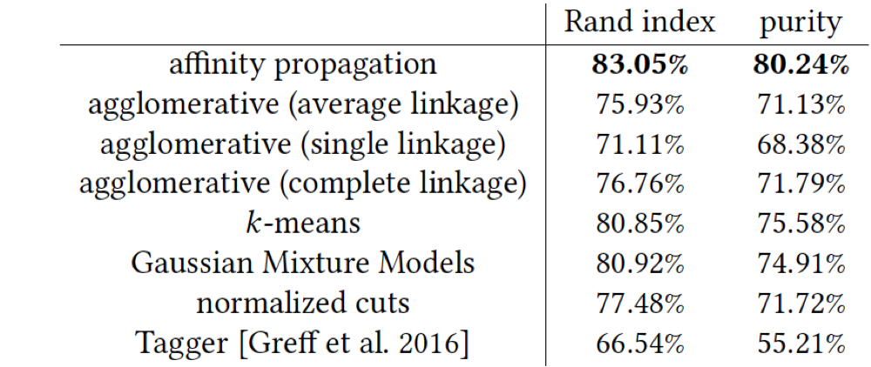
Quantitative Results with various Clustering Strategies
Notes:
Here is a comparison of different clustering algorithms. The best performance goes to the affinity propagation algorithm. Please read our paper for more details.

Slide 47
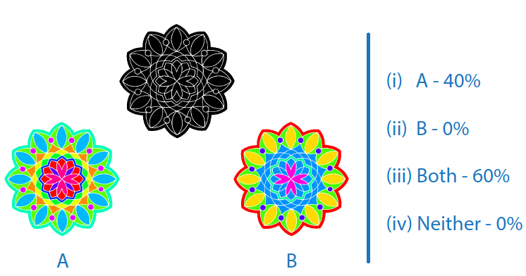
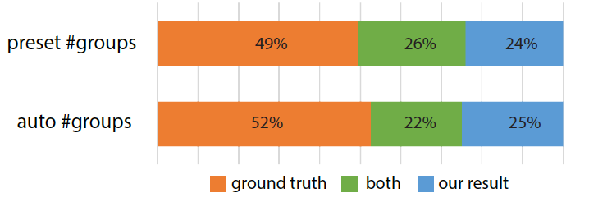
Results of User Study
Notes:
We have also conducted a user study comparing our grouping results with the ground-truth labeling. We showed those two groupings side by side, randomly flipped the order, and asked users which grouping is better. The statistics show that our grouping result is almost as good as the ground-truth labeling result. Next, we discuss the limitation of our method.

Slide 48
Limitation on model
Unreasonable grouping results
No Semantic knowledge
Unreasonable grouping results
Notes:
The major limitation is related to our model. Currently, our model does not incorporate “semantic” knowledge, that is why these twigs have not been grouped with the trunk.

Slide 49
Limitation on input data
Edge
Regions
Notes:
Another major limitation is about the input data range. Our current method only handle region-based elements. However, in real data. Graphical patterns often have various element types. For examples, this butterfly has edges of different thicknesses. Some are thick regions，while other are thin edges.

Slide 50
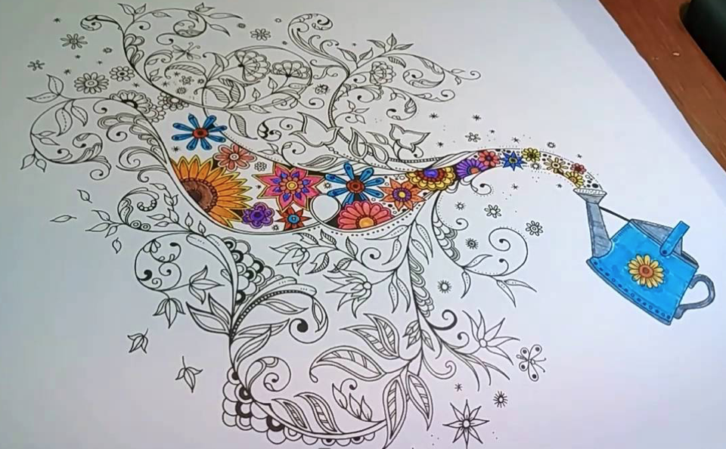
Future work: Unified Framework for Various types of Input Data
Notes:
We hope our future method can well handle the input pattern with edges of various thicknesses.

Slide 51
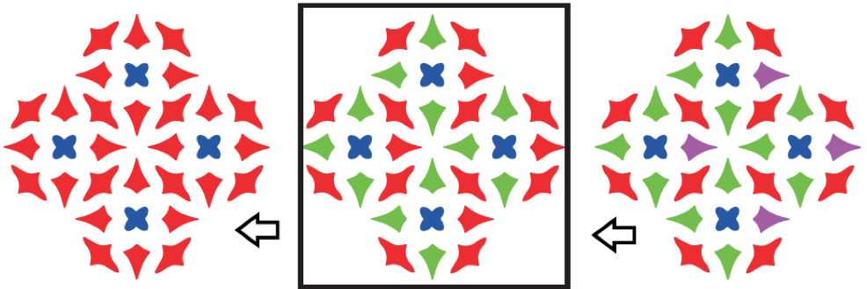
Other Future Directions: Hierarchical Grouping
The optimal result
Notes:
Another interesting future direction is to learn a hierarchical Grouping, which is actually done by human perception. Our current model didn’t have this part.

Slide 52
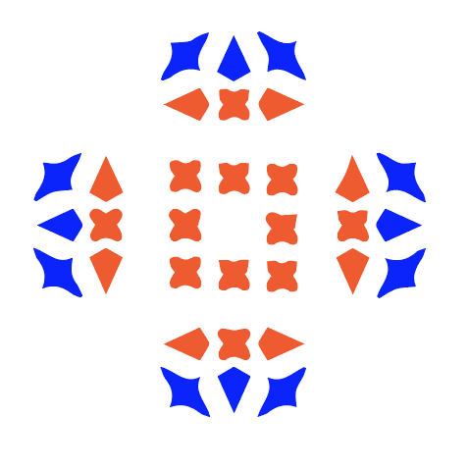
Other Future Directions: learn to rank grouping results
Input
Grouping (a)
Grouping (b)
Which Grouping Results is better?
Notes:
Apart from the above future direcitons, Iearning to rank grouping results is another potential direction. For example, like this regular pattern, there are many reasonable grouping
Results like these two: a) and (b). I believe most human would prefer (a) to (b).

Slide 53
Other Future Directions: learn to rank grouping results
Input
Grouping (a)
Grouping (b)
Ranking order Changed
Notes:
However, just move some elements’ position a little, most human would prefer grouping (b ) to (a). How to model a grouping ranking preference consistent with the statistics of human perception will be another interesting and potential problem.

Slide 54
Conclusion
First (data-driven + deep CNN) for discrete 2D patterns.
Learned shape-, context-, and structure-aware descriptors for graphical elements.
A large, annotated dataset is provided online. http://people.cs.umass.edu/~zlun/papers/PatternGrouping/
Notes:
Let’s sum up our paper, Our work is the first data-driven method trained via a deep CNN for perceptual grouping of discrete graphical patterns.

Slide 55
Conclusion
First (data-driven + deep CNN) for discrete 2D patterns.
Learned shape-, context-, and structure-aware descriptors for graphical elements.
A large, annotated dataset is provided online. http://people.cs.umass.edu/~zlun/papers/PatternGrouping/
Notes:
Our work proposed a model to Learn shape-, context-, and structure-aware descriptors encoding graphical elements.

Slide 56
Conclusion
First (data-driven + deep CNN) for discrete 2D patterns.
Learned shape-, context-, and structure-aware descriptors for graphical elements.
A large, annotated dataset is provided online. http://people.cs.umass.edu/~zlun/papers/PatternGrouping/
Notes:
Moreover, Our work contributes A large, annotated dataset of pattern which should benefit
future research on pattern analysis and processing. All the source code and data is open on the project page.

Slide 57
Acknowledgements
Dr. Ke Li for the help on experimental data preparation.
The Science and Technology Plan Project of Hunan Province.
The Massachusetts Technology Collaborative grant for funding the UMASS GPU cluster.
NSERC Canada.
Gift funds from Adobe Research.
Notes:
We akownledge all the helps, comments, and fundings for this project.

Slide 58
Thanks!
Q&A
http://people.cs.umass.edu/~zlun/papers/PatternGrouping/

